Slide 1
Object Oriented Programming
Everything is an Object
We can create Custom Objects with custom Functionality
  These are called Classes
Classes can inherit (functionality/methods and variables) from other Classes

Slide 2
Object Oriented Programming
Classes: custom / user defined data types. Used as “templates” to create Objects. Include Methods and Fields called “Members”.
Objects: Instance of a particular Class with defined data.
Members:
  Methods (Functions): Defines behaviour for an Object. Methods can be called for Objects.
  Fields (Attributes): Variables defined in the Class that store data related to that Class. (The Person Class might have String name;)

Slide 3
Object Oriented Programming
Animal
Super-Class
Sub-Class
Two-Legged Animal
Four-Legged Animal
Human
Ostrich
Dog
Cat

Slide 4
Classes and Objects / Instances
Dog
Class

Slide 5
Classes and Objects / Instances
Dog
Class
Class
Picture
Name
Age
Some Attributes

Slide 6
Classes and Objects / Instances
Dog
Class
Picture
Name
Age
Some Attributes
We want to create a new Dog!
A new Instance of the Class Dog!

Slide 7
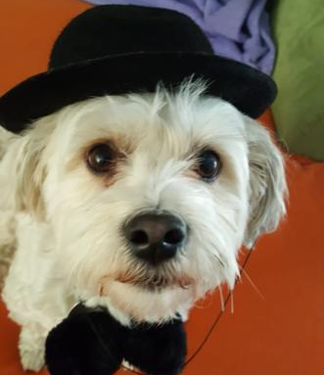
Classes and Objects / Instances
Dog
We want to create a new Dog!
Bengie
7

Slide 8
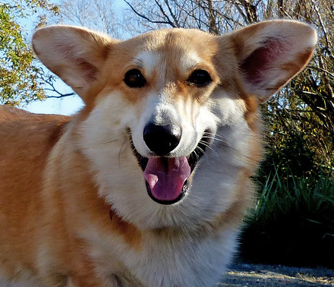
Classes and Objects / Instances
Dog
We want to create a new Dog!
Object / Instance
Bengie
Gracie
7
5

Slide 9
Welcome to the End of the Video
Like
Comment
Subscribe

